Slide 1
Energy Companies Obligation Update
David Fletcher
7 October 2014

Slide 2
Introduction to ECO
The Energy Companies Obligation (ECO) was launched in early 2013, and replaced CERT and CESP.
The scheme places legal obligations on the larger energy suppliers to deliver energy efficiency measures to domestic energy users, with a focus on vulnerable consumer groups and hard-to-treat homes.
Under the rules of ECO, energy suppliers are obliged to help improve the energy efficiency of their domestic customers’ buildings in three distinct areas:
Carbon Emissions Reduction Obligation
Community Obligation
Home Heating Cost Reduction Obligation

Slide 3
Scheme Progress
919,121 measures have been installed under ECO up until 31 July 2014¹.
Of these, 681,205 measures have been approved by Ofgem by the end of August 2014.
¹ As per DECC’s September statistical release.
² Hard-to-treat cavities (HTTCs) include narrow cavities, cavity walls in tall buildings, and in certain non-standard construction types, and those which are too difficult to treat with standard materials or require works to be carried out before installation.
³ Includes heating controls, heat recovery ventilation and warm air units.
Notes:
The next quarterly compliance update will be published by Ofgem in October. This will include an individual breakdown of suppliers progress towards their obligations, including the potential effect of the legislative changes (should they come into force) on supplier progress.

Slide 4
Supplier progress towards obligations
CERO 20.9 MtCO₂
CSCO 6.8 MtCO₂
CSCO Rural sub-obligation 1.0 MtCO₂
HHCRO 4.2£bn
Excess actions carried over from CERT and CESP are not shown in this graph.
Estimated levelisation uplift has been calculated as set out in the draft amendment Order using the relevant CERO measures installed up to 31 March 2014. Figure 3 assumes that all of these measures will be approved (including hard-to-treat cavity wall insulation).
It is possible that the draft amendment Order and in particular the provisions relating to interim measures, levelisation uplift and reduced CERO target will not come into force.
Notes:
All suppliers have nearly met HHCRO
Should the proposed legislative changes be made by parliament, they are likely to have a material effect on CERO.
Progress towards CSCO and CSCO rural had been slow, however suppliers have steadily increased their installation of interim measures over the past couple of months.

Slide 5
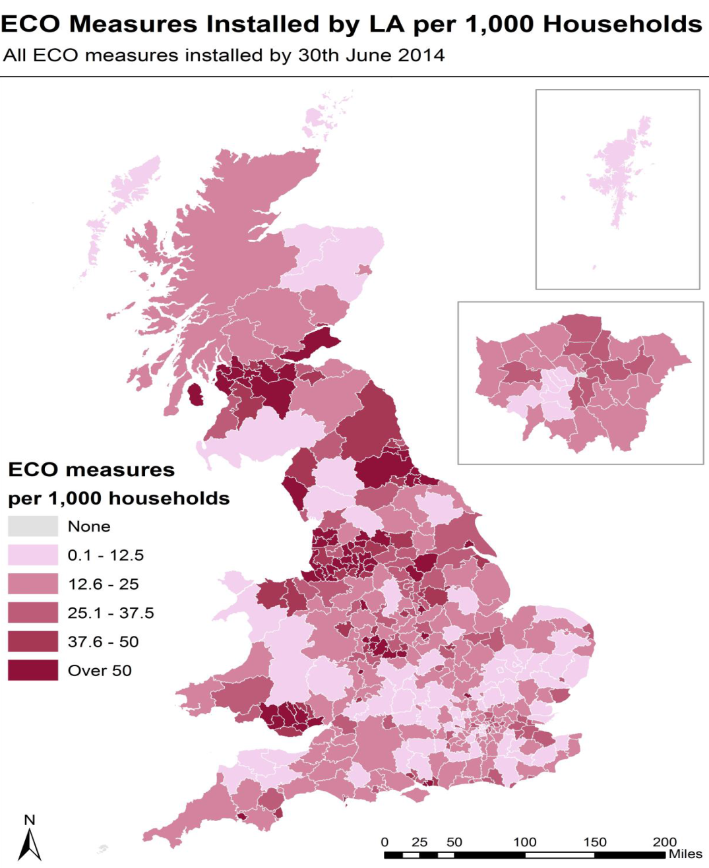
On average 35 ECO measures have been installed per 1000 households.
The highest concentration of ECO measure installs are in the North West and North East of England, South Wales and some parts of Scotland.
To the end of June 2014, 738, 729 unique households have benefitted from a measure installed under ECO.
Source: DECCs Green Deal, Energy Company Obligation (ECO) and Insulation Levels in Great Britain, Quarterly report: to June 2014

Slide 6
Sep
Oct
Nov
Dec
Jan
Feb
Mar
Apr
2017
2014
Aug
2015
May
Jun
2016
Jul
ECO 1.1
ECO 1.2
ECO 2
Publish final
guidance &
Resp. doc
ECO 1.2
ECO 1.2 laid
ECO 1.2 made
Consultation ECO 1.2
Publish Guidance
Note & response
ECO 2.1
Consultation ECO 2.1
Publish Full Guidance
& response
ECO 2.2
Consultation ECO 2.2

Slide 7
Our approach to amending our guidance
We must consult where we are required to use our discretion in interpretation
Our first priority is to provide guidance for ECO1.2 and we aim to do so by late October
In order to provide guidance as early as possible on certain areas we plan to consult on our guidance for ECO 2 in two separate consultations
Following the second consultation we expect to publish the full final guidance for ECO2 in Feb/March 2015

Slide 8
Expected legislative changes to ECO
ECO 1.2
CERO target reduction
Changes to CSCO areas
New CERO primary measures
Early CERO delivery uplift
Optimum carry forward of excess actions
Interim provision
ECO 2
Scheme extension
2015 CERO target flexibility
SWI sub-target
HHCRO changes
Surplus actions

Slide 9
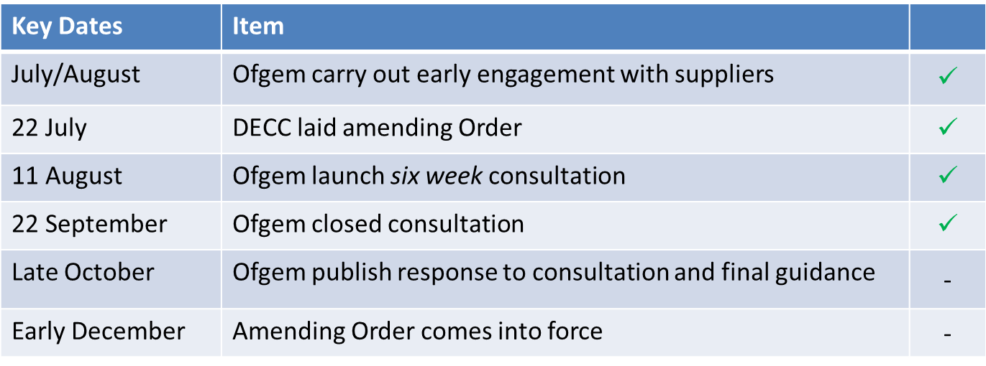
ECO Changes – ECO1
ECO 1.2 Consultation progress

Slide 10
Expected legislative changes to ECO
The proposed changes to be introduced by the new ECO Order will extend the scheme from 1 April 2015 to 31 March 2017 (ECO2)
Two further consultation periods:
ECO 2.1
Addressing some of the main requirements for HHCRO surplus actions for ECO 2
These relate to warranties and conversion factors for certain measures installed in non-gas households and boilers
ECO 2.2
Will be consulted on later in the year
Addressing all other changes that will have effect from 1 April 2015

Slide 11
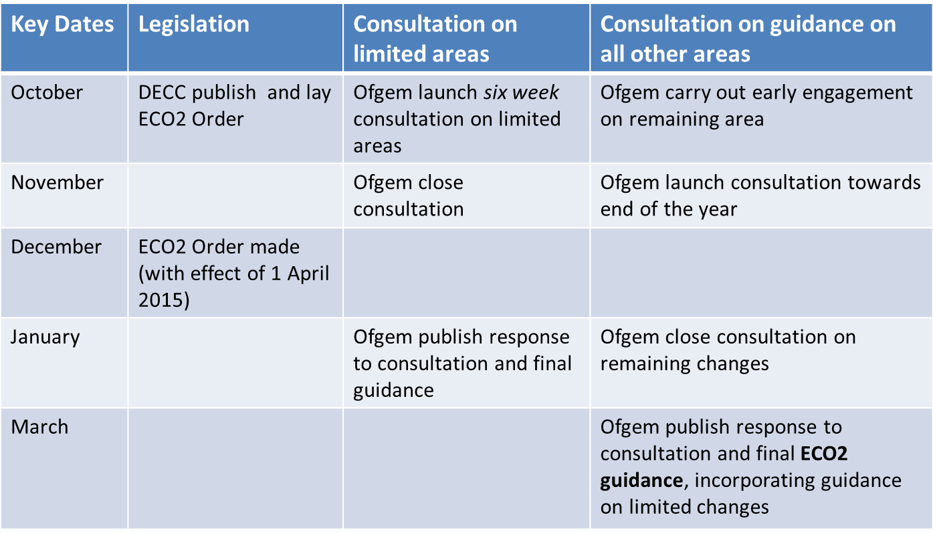
ECO Changes – ECO2

