Slide 1
The new fuel poverty strategy 3rd September 2013

Slide 2
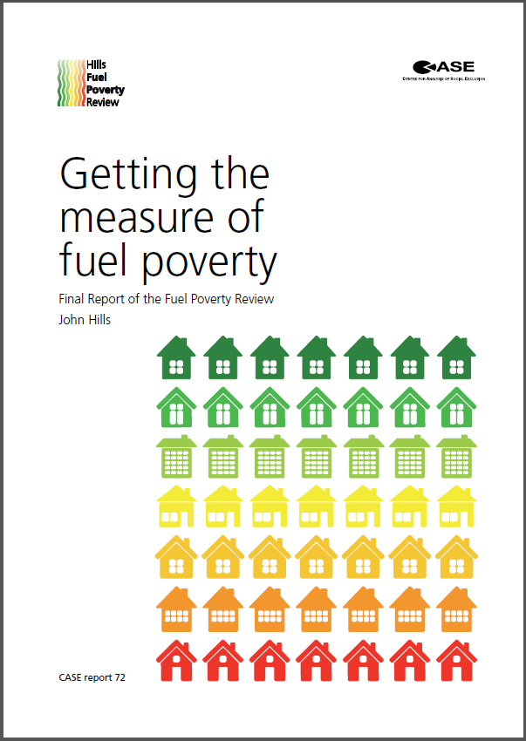
The Hills Review
Independent review commissioned in March 2011 from Professor John Hills of the London School of Economics
Key questions considered:
Is fuel poverty a distinct issue? Yes
Whether the current definition is correct? No
How fuel poverty should be measured? Low income households facing high energy costs
Final report to Government to March 2012

Slide 3
The Hills Review
Independent review commissioned in March 2011 from Professor John Hills of the London School of Economics
Key questions considered:
Is fuel poverty a distinct issue? Yes
Whether the current definition is correct? No
How fuel poverty should be measured? Low income households facing high energy costs
Final report to Government to March 2012

Slide 4
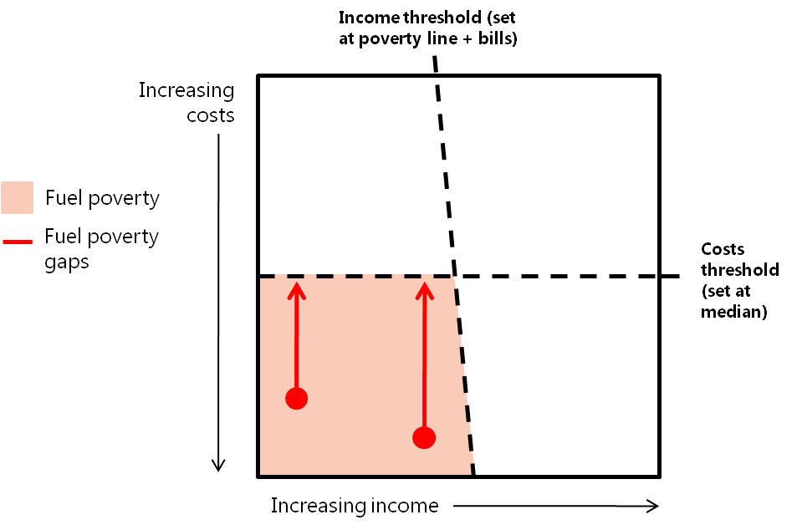
The Hills Review: the LIHC definition
Professor Hills recommended adopting the Low Income High Costs (LIHC) approach. Where a household is fuel poor where:
It has an after housing costs income below the poverty line (after adjusting for energy costs)
It faces above average (modelled) energy costs
The LIHC approach provides twin indicators that show the extent and depth of fuel poverty.

Slide 5
Beyond Hills: responding to the recommendations
September 2012: Government consultation - ‘Fuel Poverty: Changing the Framework for Measurement’ sets out our preferred approach to the fuel poverty definition
July 2013:
Confirmation that Government will adopt the LIHC approach
Amendments to the Energy Bill to align target with new definition
Publication of the strategic framework document – ‘Fuel Poverty: a Framework for Future Action’

Slide 6
The legislative framework
Current fuel poverty target enshrined in the Warm Homes and Energy Conservation Act 2000 - eradicate fuel poverty in England by 2016, as far as reasonably practicable
Amendments to the Energy Bill:
Updates WHECA so that a new fuel poverty target can be established through secondary legislation;
That new target will be supported by a statutory strategy.
We will consult on the form, date and level of this new target after Royal Assent. In principle, we intend to frame a target around the energy efficiency standards in fuel poor homes.

Slide 7
The strategic framework
The strategic framework document sets out how Government will use the new LIHC indicator to help to shape future policy decisions.
The framework sets out the results of ground-breaking analysis that helps us to understand:
The characteristics of the fuel poor; and
The most cost-effective ways of supporting the fuel poor.

Slide 8
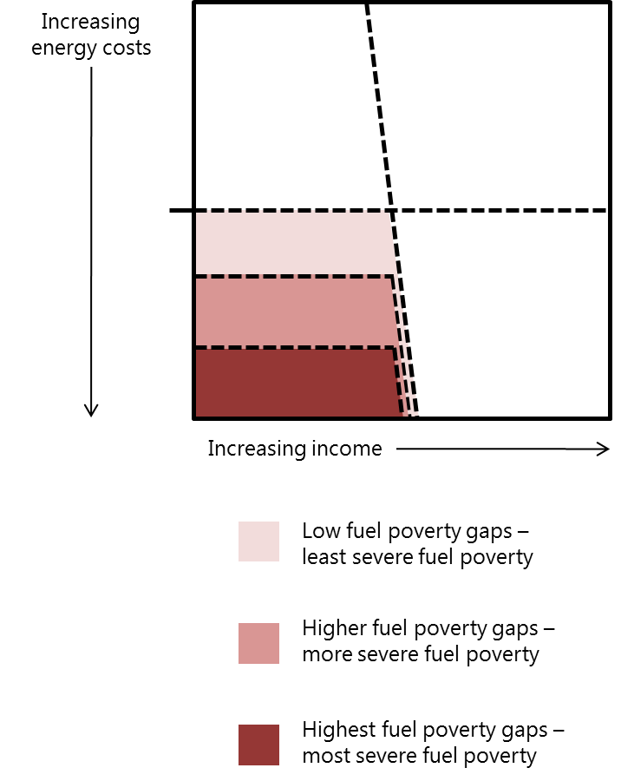
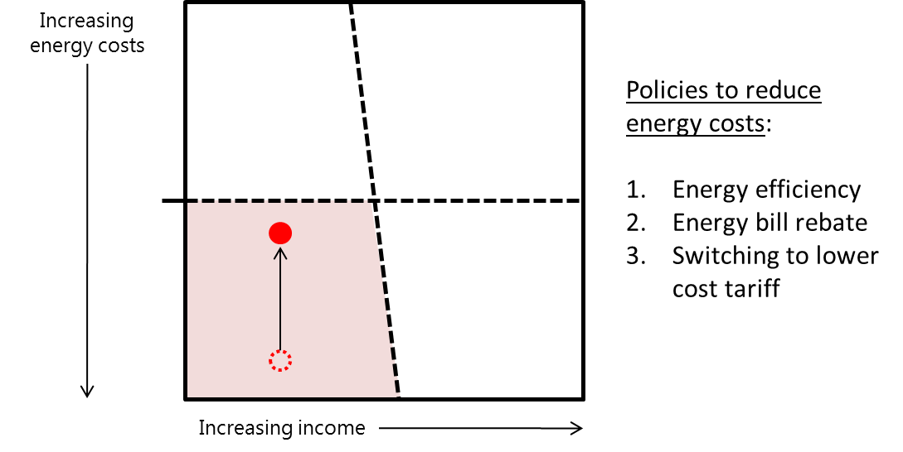
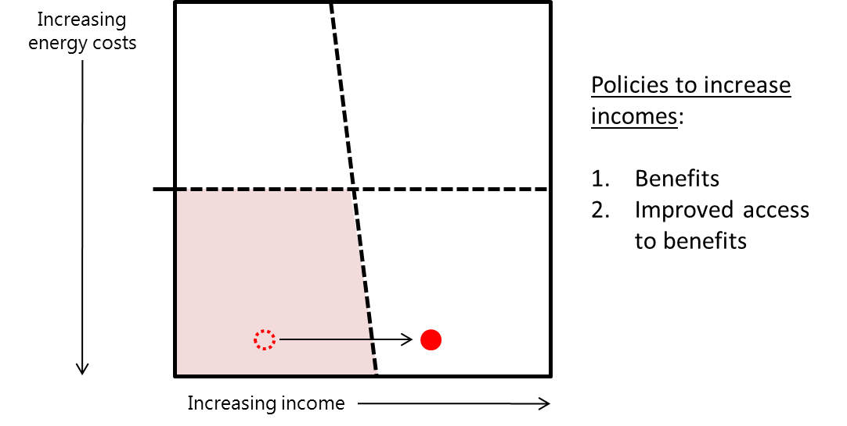
Moving from the new indicator to a revised strategy
Who should we prioritise for support?
How should we support those households?

Slide 9
Guiding principles of future policy development
The LIHC definition helps us to identify a set of ‘guiding principles’ that we can use both to assess the effectiveness of our current package and to help shape the development of future fuel poverty policies:
Prioritisation of the households that are suffering from the most severe problem;
Supporting priority households through cost-effective policies; and
Ensuring that the vulnerability is reflected in fuel poverty policies.

Slide 10
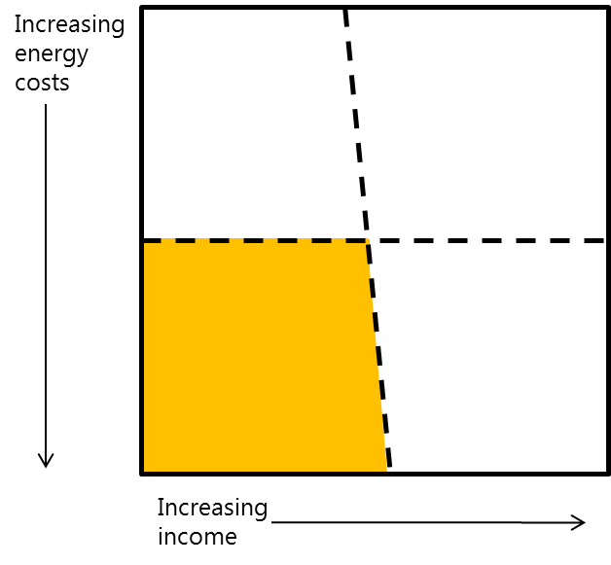
Using the new framework to develop the new strategy
Government has a package of measures across the ‘three drivers’ which we expect to deliver support to many severely fuel poor households.
Efficiency: Green Deal, PRS, heat strategy
Prices: helping customers to switch to a better deal, smart meters, Warm Home Discount
Incomes: Universal Credit, WFP, CWP
It will be important for us to understand how effectively all of our policies are supporting fuel poor and severely fuel poor households.

Slide 11
Next Steps
Sep | Oct | Nov | Dec | Jan | Feb | Mar | Apr | May
Energy Bill considered in Parliament
This is a provisional timetable
Royal
Assent
Commencement
Working with stakeholders and internally to prepare target and strategy
FPAG workshop
Consultation on target and strategy

