Slide 1
Identifying the need
BEIS funded strategy project – April 2017 to March 2018
One of nine in first funding round
Tri-LEP Local Energy Investment & Delivery Strategy
Mapping, Analysis and Modelling
Web-based stakeholder portal

Slide 2
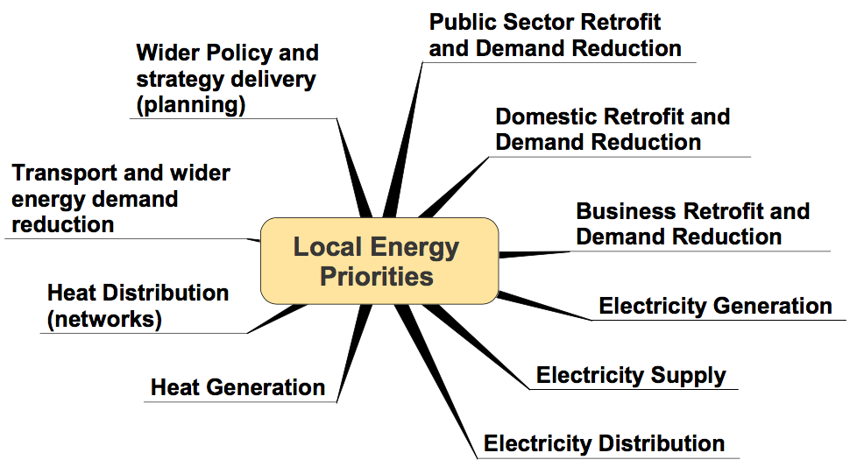
What is local energy?
Identified by Government in ten sub sets

Slide 3
Understanding the area
Three broad thematic priorities
Housing growth and commercial site infrastructure
Electrification of transport infrastructure
Affordable, secure, low carbon consumption in all sectors
Inter-relatedness and tensions for growth

Slide 4
Agreeing the strategy
Engagement with stakeholders from all sectors
Prioritising area needs for
Generation and storage
Supply and distribution
Aggregating projects
New Energy Innovation (approach, method, funding)

Slide 5
Planning together
Greater South East Local Energy Hub
East of England, Greater London, the South East and the Oxford to Cambridge growth corridor (16 counties)
Dedicated technical resource funded by BEIS for 2 years
Project identification, feasibility, funding readiness & delivery
Opportunity to test, pilot, scale up and accelerate delivery

Slide 8
The Future
Seeking strategy endorsement by all 38 local authorities
Evolving the web portal
The ‘Central Energy Intelligence Observatory’
Harmonising local, domestic and European funding
Special Purpose Delivery Vehicle
Multi-Utility Service Company (MUSCo) set up
Community and stakeholder owned
Reinvestment of profits into wider ‘local energy’ agenda

