Slide 1

Battery Storage, Reducing Fuel Poverty, Increase in Self Consumption and Integration into Low Cost Tariffs
St John Bickley

Slide 2
Agenda
• Types of Battery Storage
• Battery and Inverter Sizing
• Effects on Self Consumption in Solar installations
• Low cost Tariffs without solar
• Conclusions
• Q&A
2

Slide 3
Types of battery storage
• AC Coupled - normally parallel connected to the mains, with an import/export measurement system
• Works with any type of solar production
• Can be used without solar
• Optional future Grid Balancing Services
• DC Coupled – typically called a hybrid system. Batteries fed from solar panels via a DC/Dc converter, then to inverter
• Conventional type system, no option for optimisers etc
• Needs solar
• Presently too slow for balancing services
3

Slide 4
Battery and Inverter/charger sizing
• Optimal battery size (solar)is between 4.8kwhrs and 7.2kwhrs –
due to PV sizing/production
• Optimal sizing (low cost energy) is 7.2kwhrs to 12kwhrs
• Inverter sizing – slow and long or hard and fast?
• Battery life, how long,warranty, EOL
4

Slide 5
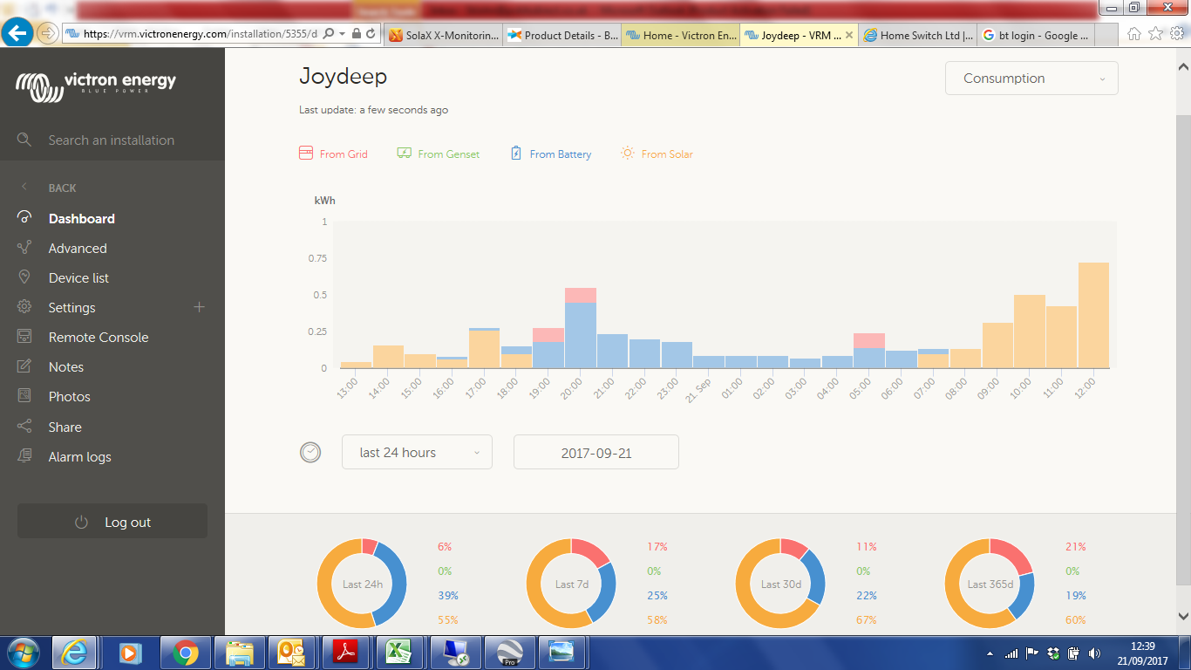
Effects on Self Consumption on solar systems
• Without battery consumption can
be between 30% and 50% depending
on occupancy and use
• With Solar aim for at least 80% self
consumption -depends on battery
size and charging rate
5

Slide 6
Effects on Consumption using low cost energy
• Not directly comparable to solar
• Aim to cover all day time loads from the stored low cost energy
• Savings determined by gap between energy costs and battery size
• Both systems require consumer buy in to reduce bills
6

Slide 7
System Costs
• Currently an AC coupled system with a 4.8Kwhr system can be supplied to the contractor
for circa £1850.00 ex VAT and delivery, extra battery costs would be circa £625.00
• Volume would further reduce costs
Income Streams
• FIT
• Export
• Possible PPA with supplier
• Grid Balancing services via VPP
7

Slide 8
Conclusion
• It is now possible to reduce a households energy consumption to 20% of original figure
using a combination of solar and battery
• Low cost energy can cover all day time loads
• It is possible to have both, especially useful in winter
• Grid services are the future for income streams
8

