Slide 1
Community Energy & Affordable Warmth East Midlands Carbon Action Network 3rd March 2016

Slide 2
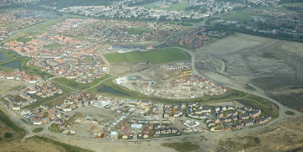
Corby now and the future
Regeneration - We’re the 5th fastest growing Borough in the UK
Set to double by 2030
61,300 residents of which 11% are on means test benefits
2,300 houses are classified as vulnerable households
8% fuel poor Corby, decreasing trend

Slide 3
Strategy and policy - Corporate Plan, PRIDE - Housing Strategy - Affordable Warmth Strategy - HECA - Climate Local Commitment ‘Action on Climate Change’ - Northants Warm Homes

Slide 4
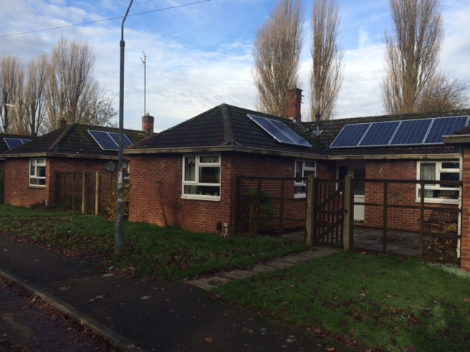
Corby’s successes to date
Corby’s Carbon Emission per household has fallen to 1.9 (baseline 2.7 TCO2 in 2005)
3716 homes under CERT scheme
1,802 homes receiving ECO measures
Electric Corby Community Energy tariff
Social Solar Project

Slide 5
Northants Warm Homes Partnership
One point of contact
Housing and Energy Officers
Established late 1990’s
8 local authorities

Slide 6
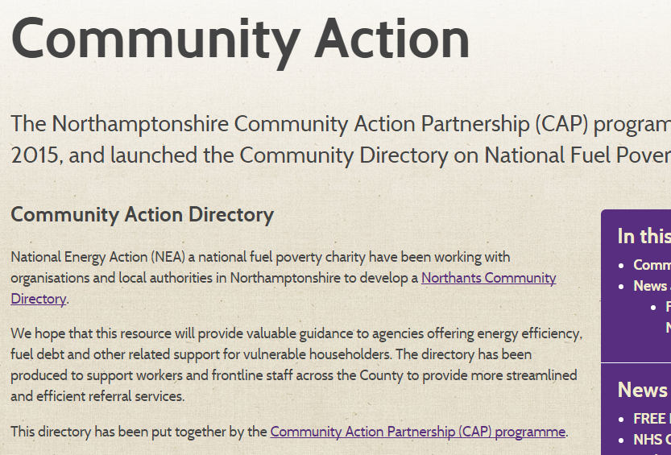
Community Action Partnership
Community Directory
284 energy awareness training
101 community champions
14 + 11 City and Guilds
Fuel Poverty Summit

Slide 7
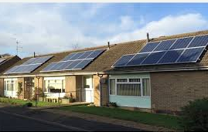
What’s next?
Renew Retrofit EWI
Electric Corby
ECO3
Smart Meter Rollout
Health & wellbeing Boards

Slide 8
Thank you
www.northantswarmhomes.com/about/community-action/
www.corby.gov.uk/home/green-corby
sara.earl@corby.gov.uk
01536 464682

