Slide 1
The Hills Fuel Poverty Review An overview of recommendations and their implications for practitioners.
East Midlands Carbon Action Network, 20th September, 2012
Lauren Probert, Loughborough University
Notes:
1) The fuel poverty gap
2) Impact of neutralising of energy prices
3) How to achieve the definition
4) The dangers on smaller households
5) What professionals should do to identify and help the fuel poor

Slide 2
“…that as far as reasonably practicable persons do not live in fuel poverty” Warm homes and energy conservation act 2000

Slide 3
Fuel poverty can be said to exist where To maintain
An adequate level of warmth in the home:
Unit Price
Of fuel
Quantity of fuel required
Household income
x
≥
10%
x
Notes:
The current definition of fuel poverty, which many of you will be familiar with, was originally proposed by Brenda Boardman (who I believe has spoken at this forum before) in her PhD and subsequent 1991 book Fuel Poverty. This defines a fuel poor household as one that spends greater or equal to 10% of its income on all energy use, whilst maintaining an adequate level of household warmth. This is at the root of the current government definition, which has attached a methodology, and selected ways to define “adequate warmth” and “household income”. I’m not going to dwell too much on the details of these, as I suspect you’ll be familiar, but we can always return to then at the end.

Slide 4
Uses fixed proportion of income (10%).
Proportion based upon 1988 figures.
Ratio effect means that any change to spending has 10x more impact than change to income.
Factors such as fuel prices (but also temperature regimes and low misreported incomes) have enormous impact and drown out positive impacts of schemes.
Only a headcount figure, doesn’t account for depth.
Income taken Before Housing Costs.
Income not equivalised.
Includes those on very high incomes (against principles of WHECA).
Notes:
The current definition has strengths and weaknesses
Strengths:
Modelled (by government)
Core factors stand up.

Slide 5
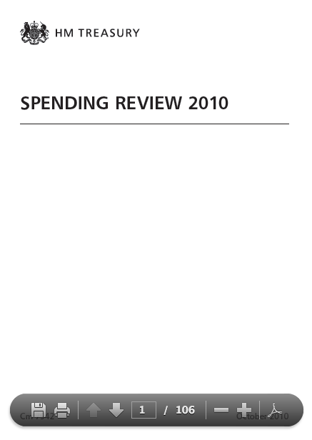
“The Government is committed to focusing the available resources where they will be most effective in tackling the problems underlying fuel poverty. The Government therefore intends to initiate an independent review of the fuel poverty target and definition before the end of the year.” (p. 62)
Notes:
Review
Reasons – depends on how cynical you’d like to be.

Slide 6
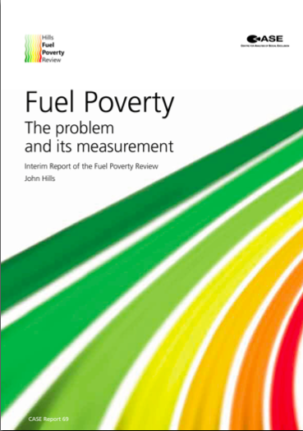
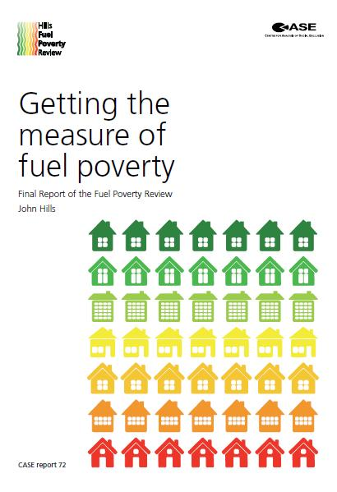
Notes:
John Hills released an interim report in November 2011, and a final report in March 2012.

Slide 7
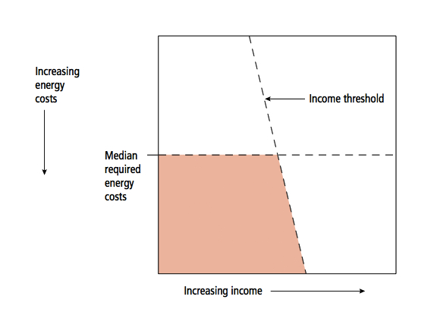
Notes:
The core recommendation was for a shift from the current definition to a new LIHC (low income high costs) indicator.

Slide 8
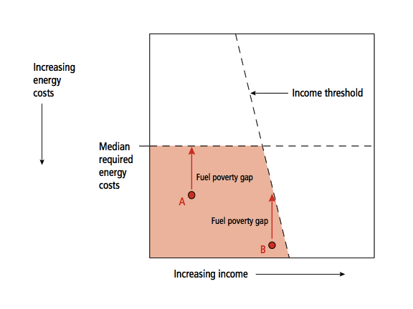
Notes:
Fuel poverty gap

Slide 9
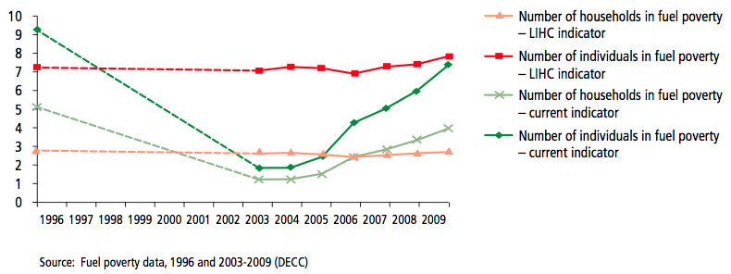
Number of households in fuel poverty (Boardman definition): 4m
Number of households in fuel poverty (Hills definition): 2.7m
Number of individuals in fuel poverty (Boardman definition): 7.4m
Number of individuals in fuel poverty (Hills definition): 7.8m
(2009 data)

Slide 10
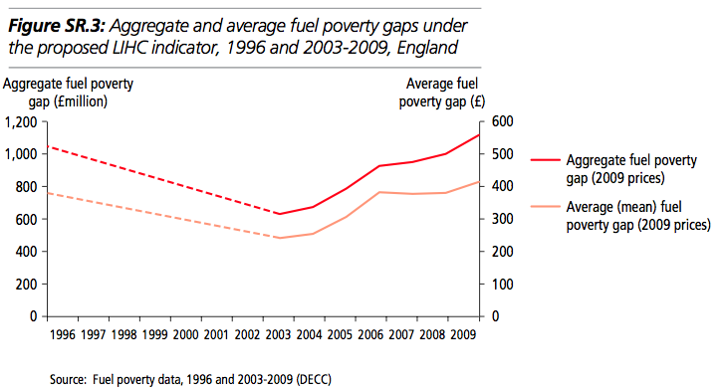
Aggregate fuel poverty gap (2009 data): £1.9 billion.
Mean fuel poverty gap (2009 data): £414/household.
Notes:
Fuel poverty gap

Slide 11
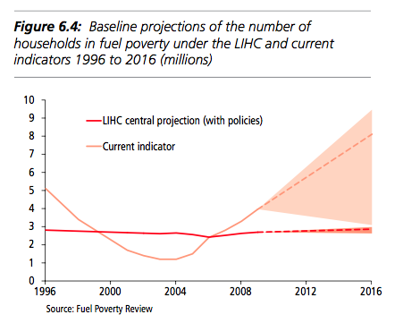
Notes:
Demonstrates impact of neutralising energy prices.

Slide 12
Notes:
What this means for the make-up of the fuel poor

Slide 13
Region | Boardman (%) | Hills (%)
East England | 10.8 | 10.8
East Midlands | 9.7 | 10.3
London | 9.4 | 14.1
North East | 6.7 | 6.4
North West | 17.0 | 15.5
South East | 11.3 | 11.0
South West | 9.7 | 9.7
West Midlands | 13.7 | 12.5
Yorkshire and the Humber | 11.7 | 9.7
Notes:
Fuel poverty in the East Midlands

Slide 14
Uses fixed proportion of income (10%)
Proportion based upon 1988 figures.
Ratio effect means that any change to spending has 10x more impact than change to income.
Factors such as fuel prices (but also temperature regimes and low misreported incomes) have enormous impact and drown out positive impacts of schemes.
Only a headcount figure, doesn’t account for depth.
Income taken Before Housing Costs.
Income not equivalised.
Includes those on very high incomes (against principles of WHECA).
Notes:
How does it tackle issues with old definition (cross them out).
I prefer it!
It’s about equality
AS do Government, as of Tuesday – they’ll still be including the old definition in statistcs though
! But very ambitious

Slide 15
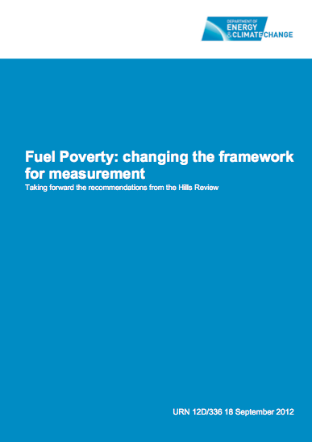
Consultation Response Deadline:
30th November 2012
http://www.decc.gov.uk/en/content/cms/consultations/fuel_poverty/fuel_poverty.aspx
Notes:
Controversies – issues over threshold, should it be more ambitious?
Government want to still count DLA as income (hills suggested considering otherwise). Government usually do include them, want to be consistent.
How to eradicate fuel poverty? Not impossible! But very ambitious – consultation suggests a change to WHECA primary legislation.

Slide 16
Will the new definition impact upon practitioners? In practice, proxies are used anyhow.
ECO criteria already set!
Difficulties in finding the fuel poor (i.e., SPG).
May change focus and means of engagement.
Maintaining current target will require intensive effort (but are Government likely to support that?)
Will the 2016 target change (and reduce priority?)
Notes:
What this means for practitioners
Identifying the fuel poor – in practice, we use proxies.
Issues with Super Priority Group
More focused – but harder to find/engage?

Slide 17
Thank you.
l.probert@lboro.ac.uk

