Slide 1
Big energy race
EMCAN
April 2015

Slide 2
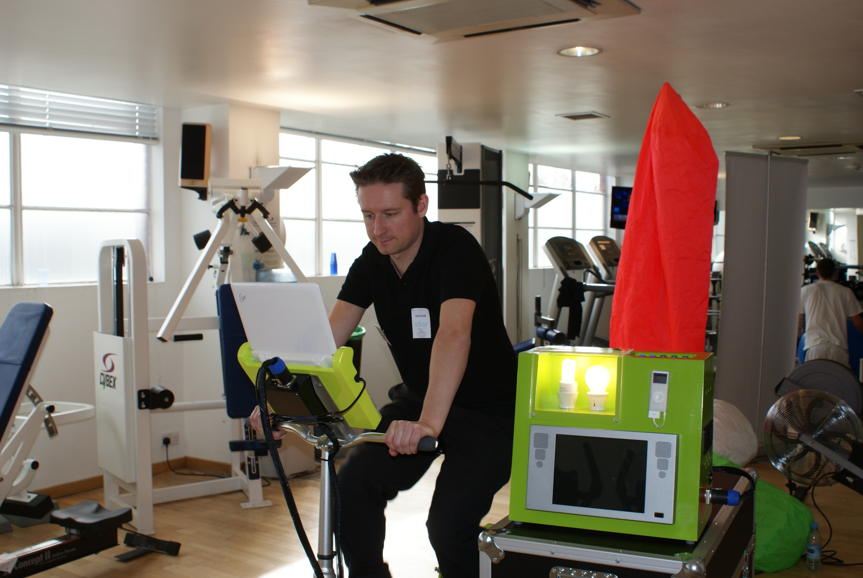

Slide 3
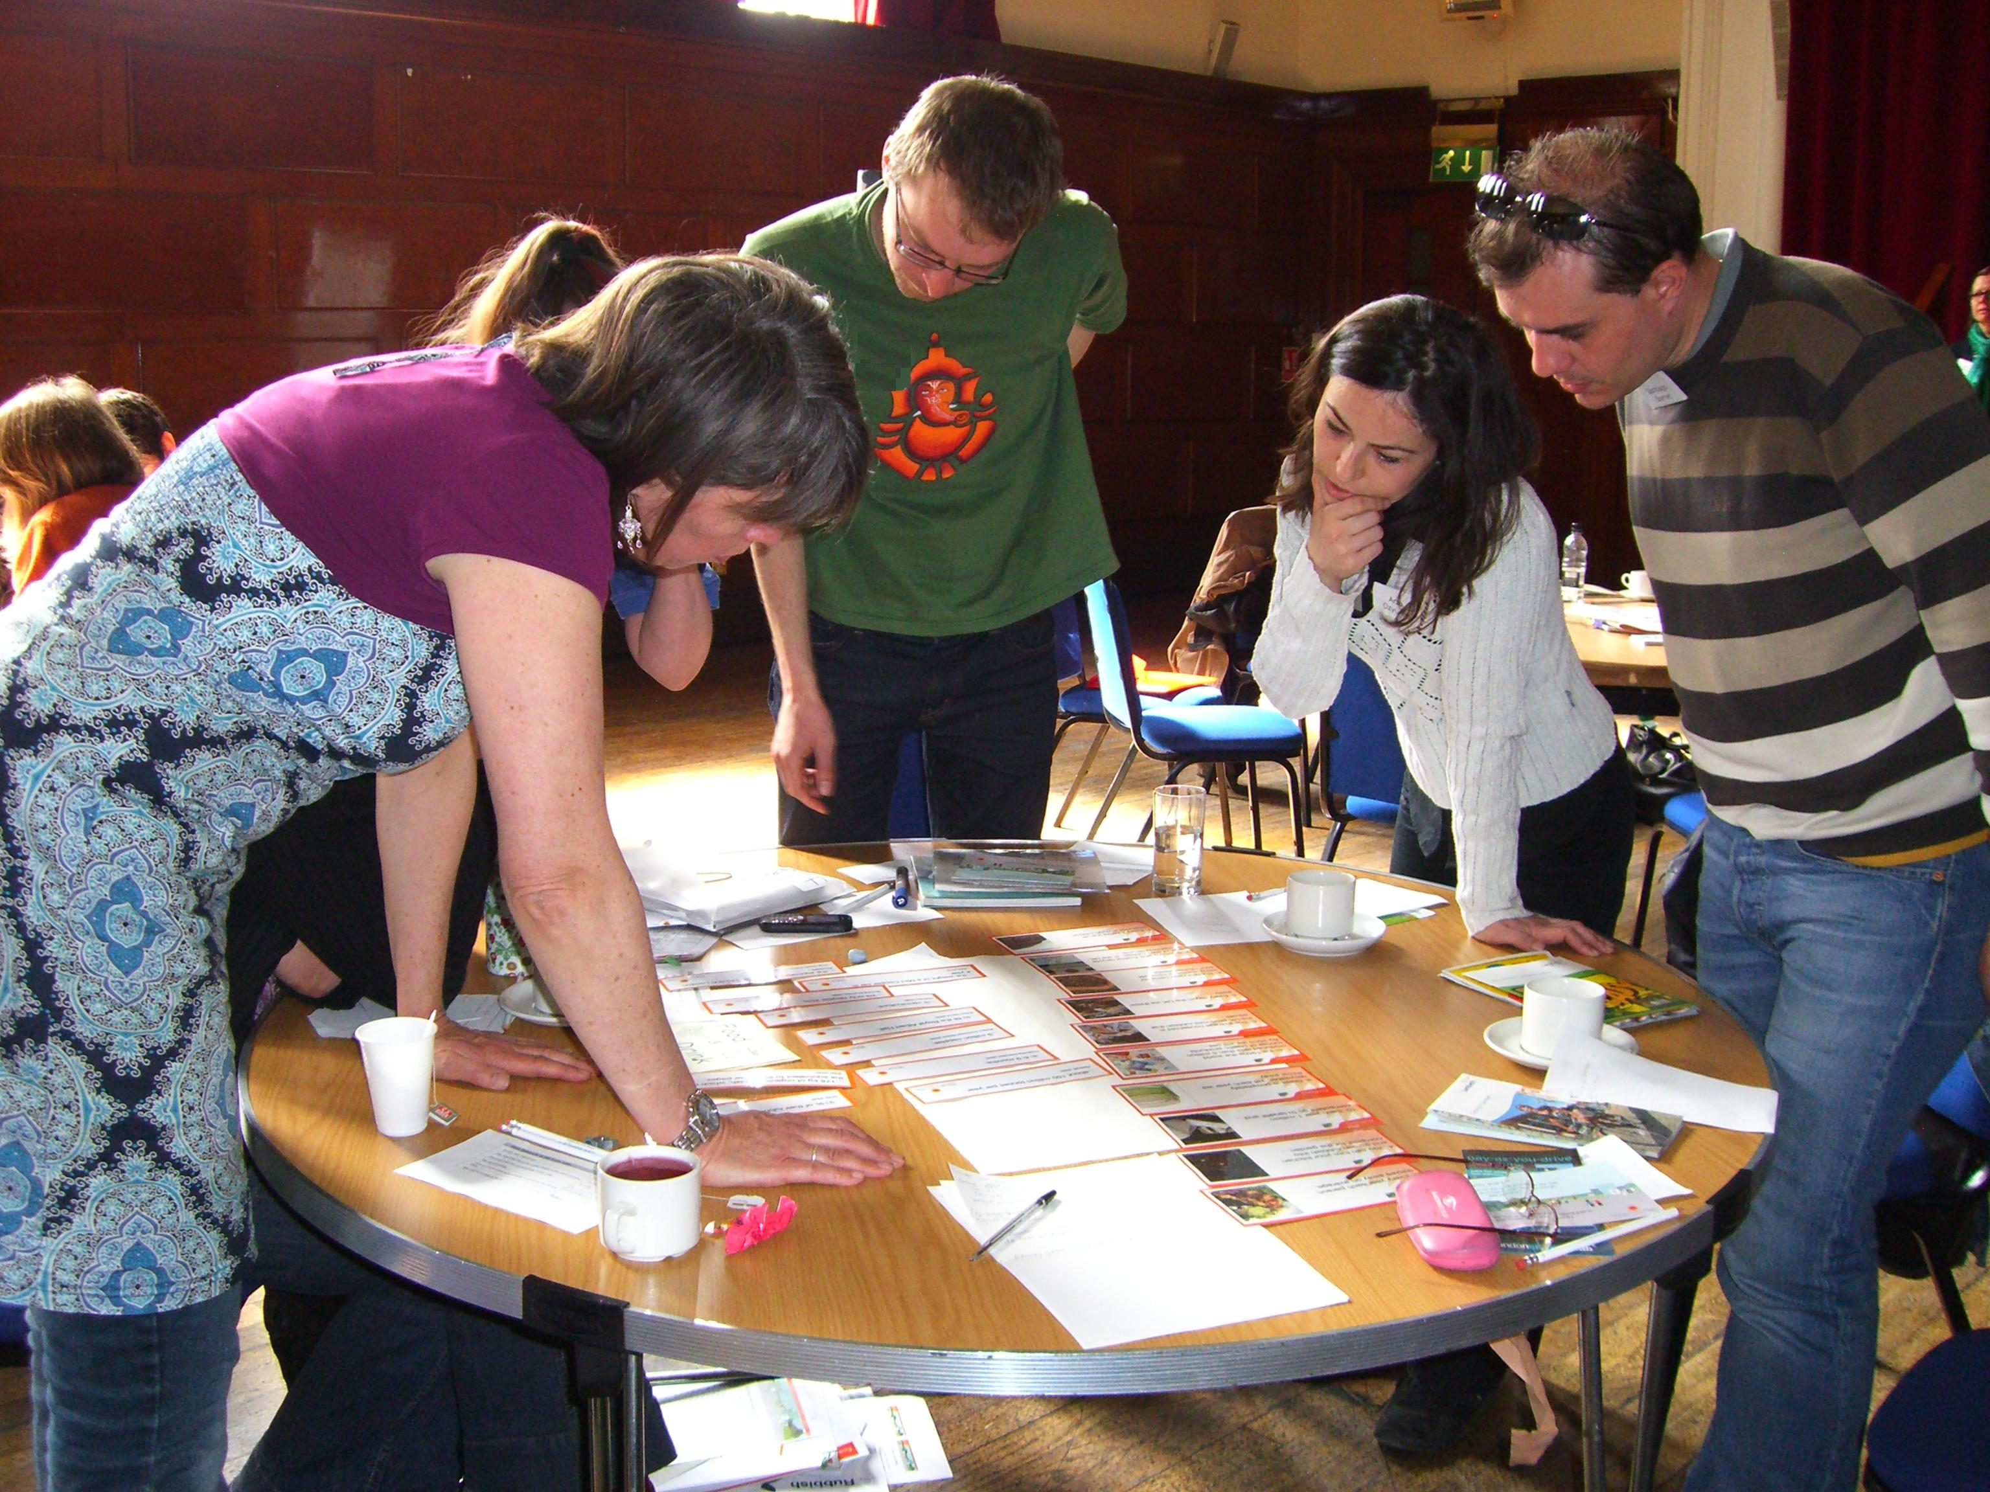

Slide 4
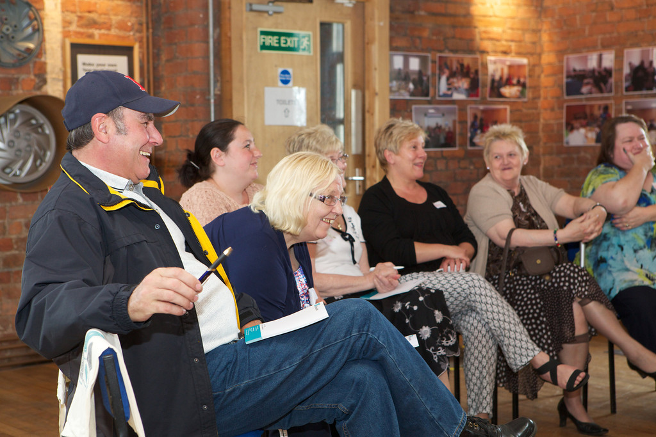

Slide 5
Supporting local engagement
Community group leader
Community group members
Friends, family, neighbours, local community

Slide 9
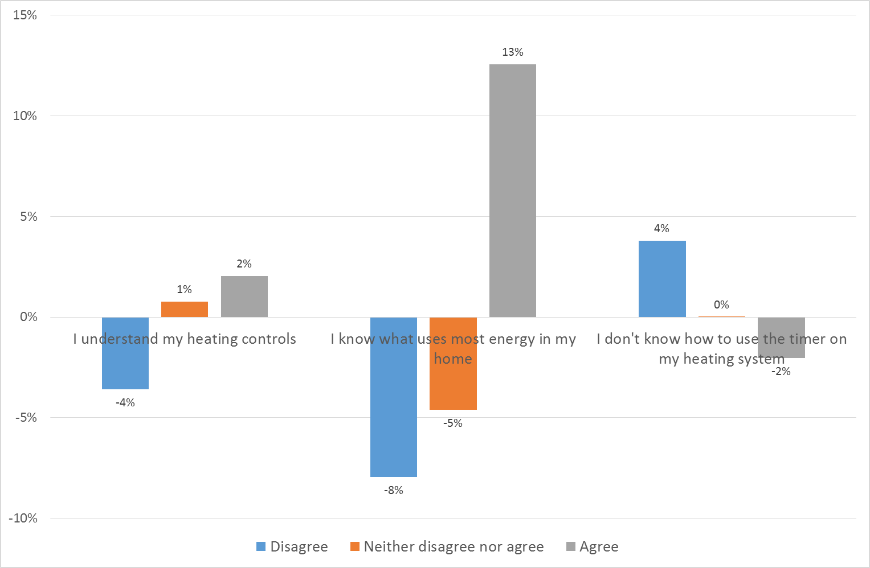

Slide 10
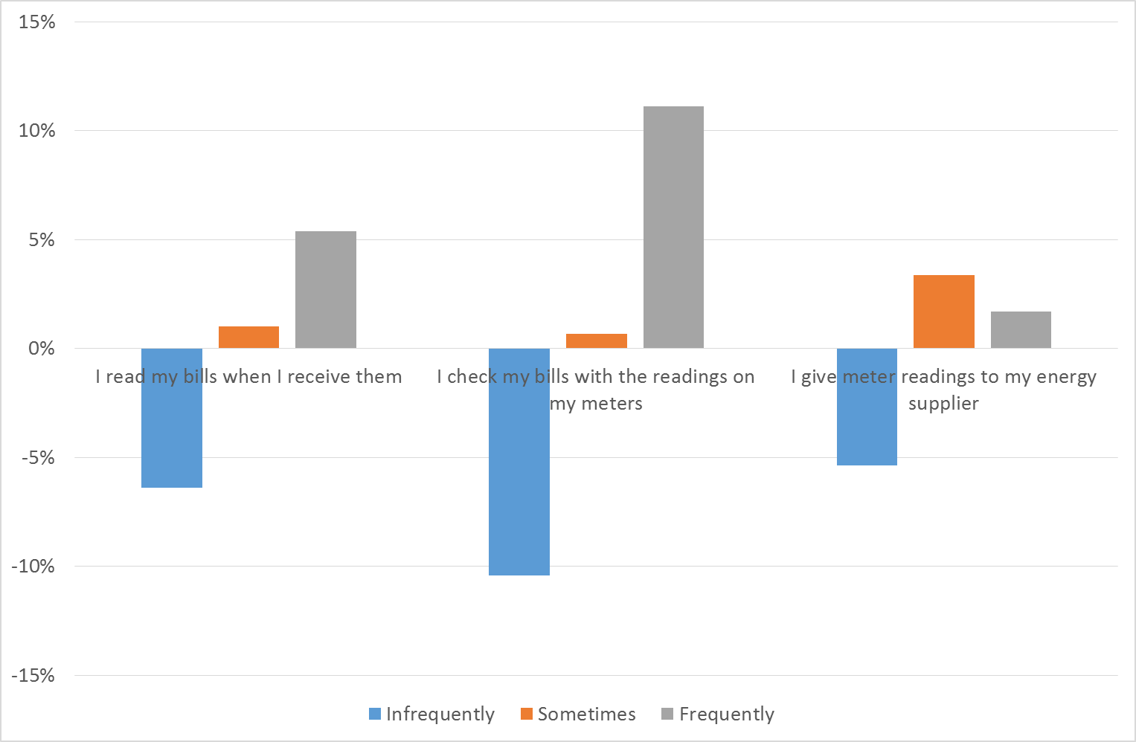

Slide 11
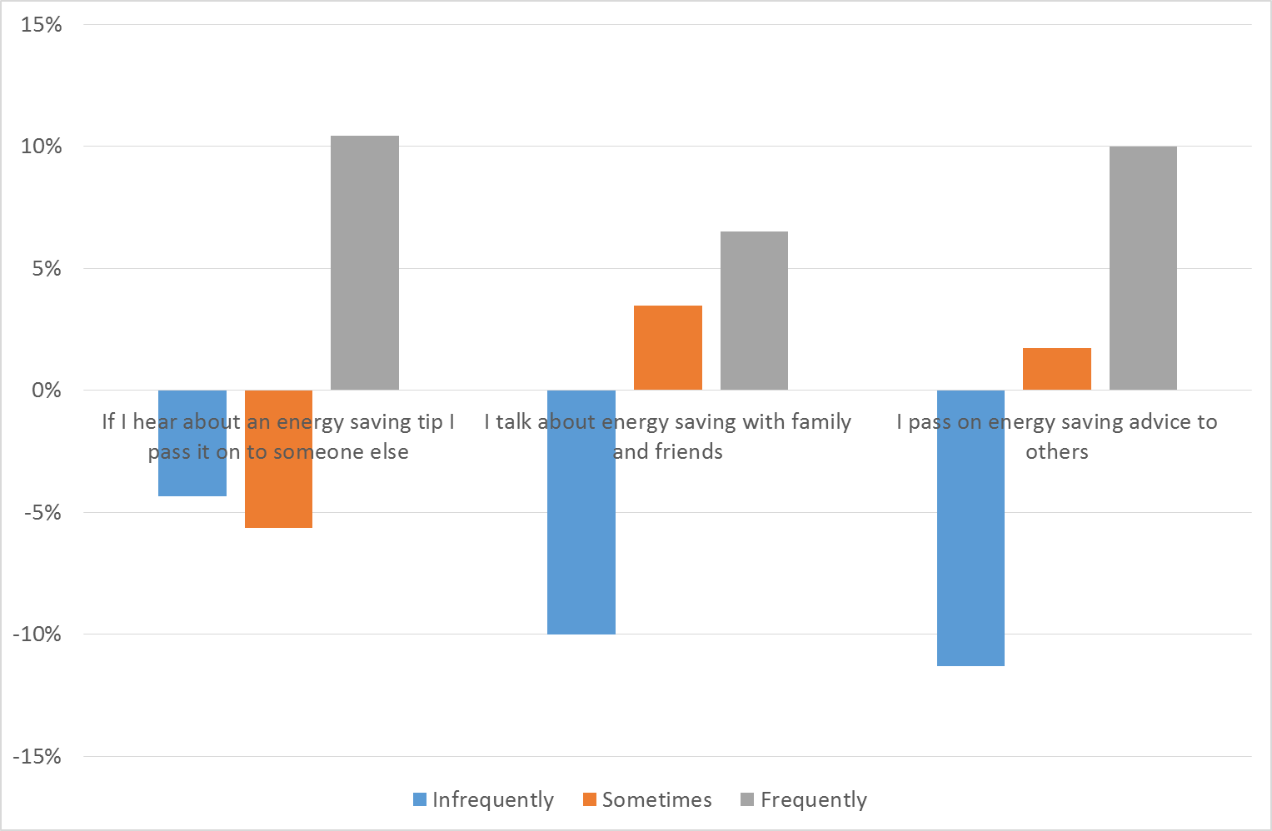

Slide 13
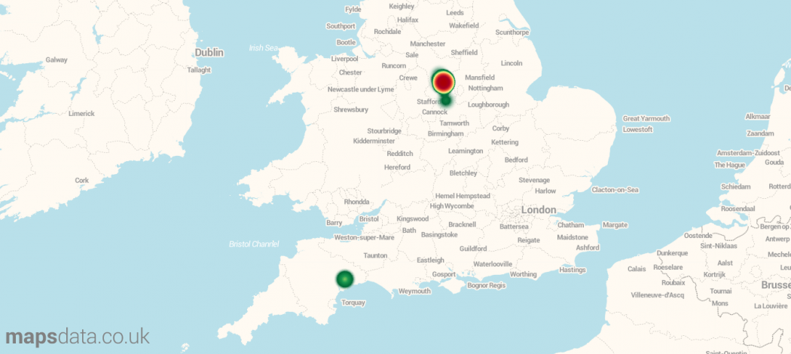

Slide 14
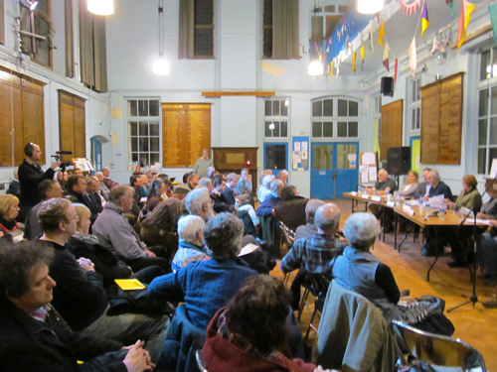
“Transition Belper ran a 'Climate Change Question Time' debate.
For a 'warm-up' the BELPER GOES GREEN! Team explained how to use the fridge magnet packs.”

Slide 15
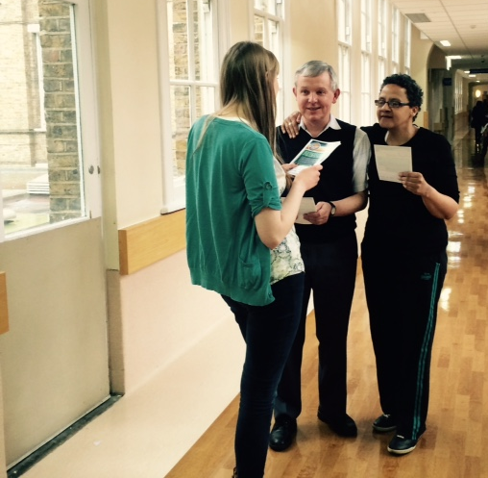
“During my lunch hour today I went out into the hospital spreading the word about the Big Energy Race and providing visitors with some useful lessons to take home and apply to their own homes!
Hopefully my helpful lunch hour lessons have equipped them to save energy and money!”

Slide 16
