Slide 1
East Midlands Carbon Action Network Meeting
Jo Giles
Strategy Implementation Manager (National Grid)
Mark Ducker (NG-AWS)
Business Development Manager
April 2015

Slide 2
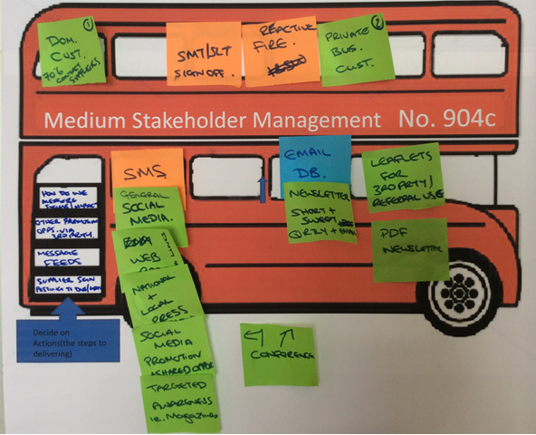
Equal outcomes
National Grid Vulnerable Strategy
5 key priorities
Deliverables
Customer Safeguarding
Working in a different way!
Energy Industry-wide
Sub Groups
Priority Service Register
Ofgem Open Letter
Long term ambition
Needs Codes
Referral Networks
- Partnerships with ‘real’ impact
UK Gas Distribution

Slide 3
National Grid Affordable Warmth Solutions
An independent Community Interest Company established by National Grid to deliver its initial regulatory commitment to Ofgem of 5,000 new gas connections by March 2013, extended for a further 3 years to deliver a further 3600+ connections.
Originally chaired by the late, former Energy Minister, Rt. Hon. Malcolm Wicks, MP; consumer interests on the Board are represented by Non-executive Director, Jenny Saunders, Chief Executive, NEA ;
Current Chair – Rt. Hon. John Healey, MP
Has a £20million ‘arms length’ contract with National Grid to deliver its fuel poverty programme ;
Current turnover c£6.2million pa. with all profits reinvested in Community Schemes and Fuel Poor initiatives e.g. Heating systems for non-qualifying households, off-gas grid initiatives, fuel cell technology.

Slide 4
National Grid Affordable Warmth Solutions
National Grid Affordable Warmth Solutions are offering qualifying householders free or discounted gas connections .
What is the Qualifying Criteria?
Live in one of the top 20% most deprived areas in National Grid’s gas network area; Or
Spend more than 10% of their disposable income to heat their property to an adequate level of warmth; Or
Are aged 70 or over; Or
Are in receipt of certain income related benefits:

Slide 5
Innovative Solutions – the AWS approach
All independently funded through retained profits and not supported by Government or Ofgem Fuel Poor Schemes.
Multi occupancy buildings – heat networks
Off-gas grid Air Source Heat Pump pilot study
Innovation Awards to 5 Projects with a total of £400,000 of support (City West Homes Project, Walsall Housing Group Project, Southway Housing Project, Suffolk Coastal District Council and Derbyshire County Council Project).
Bursary for poorer Students
*further information can be found at https://www.affordablewarmthsolutions.org.uk/media/news*

Slide 6
The Heat Solution – Doveton House

Slide 7
Heat Networks – the social argument
Benefits to the consumer
Removes gas meter, appliances etc. from individual properties;
Eliminates future maintenance costs of appliances, Landlord Safety checks;
Can be included with rent therefore reduces complexity of energy supply chain;
More environmentally acceptable;
Greater energy efficiency and reduces energy bills.
Critically, 24/7 back up heating and hot water supply reducing the risk of the cold to vulnerable customers.

Slide 8
Case Study-Heat Network
The primary aims of this project were to assess the financial and technical performance of the Micro CHP technology integrated with a gas fired communal heating.
The property is a 31 room sheltered housing complex, residents who are over 65 years of age.
The regeneration project involved the removal of individual gas supplies to the tenant’s flats, replacing their Baxi Bermuda room heaters with a centrally controlled gas fired community heating scheme.
In addition, tenants were provided with new kitchens and bathrooms. Two Micro CHP units were fitted in the boiler room, to supply heat and electricity to the communal facilities, and so protect tenants standing charges (relating to the shared facilities) against cost increases.

Slide 9
Case Study-Heat Network
As a result of the installation of Innovative technologies and central gas fired heating system, the building required less imported electricity from their supplier than during the previous year and a reduction in gas usage.
A reduction in electricity tariff was also negotiated during the year, and the chart below compares the pre and post installation time periods.
This didn’t affect the comfort levels of the individual flats and residents

Slide 10
Case Study-Heat Network
 | Pre-installation |  | Post installation |  | Difference (numeric) |  | Difference
 | 2013/14 |  | 2014/15 |  |  |  | (%)
 | kWh | Cost | kWh | Cost | kWh | Cost | kWh |  | Cost
Electricity | 47,805 | £6,957 | 27,761 | £2,805 | -20,044 | -£4,152 | -41.90% |  | -59.70%
Gas | 297,705 | £16,020 | 385,147 | £15,585 | 87,442 | -£435 | 29.40% |  | -2.70%
Total | 345,510 | £22,977 | 412,908 | £18,390 | 67,398 | -£4,587 | 19.50% |  | -20.00%
Including Tenants Gas Bills
Gas | 286,750 | £11,470 | 0 | £0 | -286,750 | -£11,470 | -100% | -100%
Grand Total | 632,260 | £34,447 | 412,908 | £18,390 | -219,352 | -£16,057 | -34.70% | -46.60%

Slide 11
Case Study Air Source Heat Pump/Gas Infill Project
National Grid Affordable Warmth Solutions are in the process of evaluating Air Source Heat Pumps to rural properties that cannot have individual gas supplies fitted.
The site was put forward has it is unable to have a gas connection and with funding the properties would benefit from Air Source Heat Pump.
An area called Yarwell near to Peterborough was identified and a number of properties types and a mixture of tenant profiles were chosen from over 70s, families with young children and single parent families.

Slide 12
National Energy Action Role Air Source Heat Pump/Gas Infill Project
Over the next 12 months the project will be monitored by National Energy Action to ensure the project delivers the targets and objectives for Waterloo Housing/Spire Homes and National Grid Affordable Warmth Solutions.
These objectives include:
Comparison between Air Source Heat Pump and a Gas Infill project including costs of both sites, savings to utility bills and benefits to each resident.
Integrating the correct technologies into the built environment
Reducing fuel poverty for the tenant
Cheaper running costs (12 months bill analysis);
More energy efficient;
Reducing harmful carbon dioxide emissions to the atmosphere;
Clean, renewable energy;
Total controllable heating;
Customer experience 12 month report;
Tenant training report.
RSLs maintenance team training

Slide 13
Thank You
Jo Giles (National Grid)
Jo.giles@nationalgrid.com
+44(0)777 5413482
Mark Ducker (NG-AWS)
mark.ducker@ngrid-aws.org.uk
07966065675

