Slide 1
Part L 2013 – An overview
Matt Cotton (National Energy Foundation)

Slide 2
Presentation overview
Part L policy drivers
Timescales for implementation
Transitional arrangements
Domestic – Part L1 A&B
Non Domestic – Part L2 A&B
Notification & Improving Compliance

Slide 3
Part L
DRIVERS, TIMESCALES, TRANSITIONAL ARRANGEMENTS

Slide 4
What is Part L?
Conservation of fuel and power
Applies to England only (regulations devolved to Northern Ireland, Scotland and Wales)
Covers 4 building types:
L1A: New Build Domestic
L1B: Existing domestic
L2A: New Build Non Domestic
L2B: Existing Non Domestic
Sets minimum standards for:
Plant efficiency (e.g. boiler, lighting efficiency)
Fabric insulation levels
Carbon emissions (determined using software e.g. SAP, iSBEM or Dynamic Simulation Modelling)

Slide 5
Part L Policy Drivers - EU
European Energy Performance of Buildings Directive (Directive 2010/31/EU) – The “Recast” directive
Introduced in May 2010 by European Union (replaces the 2002 directive)
Part L 2013 is the Government’s response for England
Also requires:
All new buildings to be ‘nearly zero energy’ by December 2020
Public Authority buildings – should be nearly zero energy’ by December 2018
No specific targets for existing buildings
Calculation methods to focus on cost optimisation (CO₂ vs. running cost)
More rigorous procedures to check energy performance certificates (EPCs)

Slide 6
The UK Interpretation of the EU Directive
Aims of Part L 2013:
New build: Take meaningful step towards zero carbon (Homes: 2016, Non-domestic: 2019)
Respect deregulation and economic growth agendas
Existing build: explore dynamic between Green Deal and Consequential Improvements to drive retrofit of existing stock
Key consultees in developing Part L 2013 :
Zero Carbon Hub (domestic)
BRAC (Building Regulatory Advisory Committee)

Slide 7
Time-line
July 2010: Government call for ideas
Dec 2010: Statement setting out areas for consideration
January 2012: Consultation package launched – supported by impact assessment (consultation closed 27th April 12)
Oct 2012: Consequential improvements for domestic extensions (‘Conservatory Tax’ – SCRAPPED in April 2012)
April 2013: New build, existing build and consequential improvement standards laid before parliament
6th April 2014 : Part L 2013 comes into force

Slide 8
Transitional arrangements
Part L 2010 will still apply where;
Site work has begun before 6 April 2014
The work is subject to a Building Notice, Full Plans application or Initial Notice submitted before 6 April 2014 provided the work is commenced before 6 April 2015

Slide 9
Part L1
DOMESTIC BUILDINGS

Slide 10
Summary of main changes – L1A
L1A : New Dwellings – Key changes
Target for 2013: 6% reduction in CO₂ from 2010
New requirement, regulation 26A – fabric energy efficient target (TFEE)
Regulation 25B – Nearly zero energy requirements for new buildings (2019 at the earliest..)
Consolidation of amendments made in December 2012
Notes:
To achieve or better a new fabric energy efficient target in addition to the carbon dioxide target
Notional dwelling delivering 6% carbon dioxide savings over Part L 2010 – more detail later
December 2012 amendments requiring feasibility of high efficiency alternative systems to be taken into account prior to construction

Slide 11
Summary of main changes – L1A
Compliance with the five criteria (Limited changes)
Achieving the TER and TFEE rate
2. Limits on design flexibility
3. Limiting the effects of solar gain in summer
4. Dwelling performance consistent with the DER and DFEE
5. Provisions for energy efficient operation of the dwelling
Notes:
Regulation 25B referred to but wont be implemented until 2019 at earliest – further notification and guidance nearer the time
Five criteria same as 2010. Criteria 1 and 4 now include reference to the fabric efficiency

Slide 12
Summary of main changes – L1A
Target Fabric Energy Efficiency (TFEE)
DFEE (dwelling) must be no greater than TFEE (target)
FEE accounts for a dwelling’s combined, annual space heating and cooling load measured in kWh/m²,
TFEE is based on notional dwelling of the same size and shape as that being assed
A 15% margin is then added, giving the designer some additional design flexibility.
Notes:
To achieve or better a new fabric energy efficient target in addition to the carbon dioxide target
Notional dwelling delivering 6% carbon dioxide savings over Part L 2010 – more detail later
December 2012 amendments requiring feasibility of high efficiency alternative systems to be taken into account prior to construction

Slide 13
Summary of main changes – L1A
General changes to the Approved Document
Building Regulations – high level summary
List of contents and summary of sections
Mentions Energy Performance Certificates (EPC)
Change in overall format
Notes:
High level summary - clarification on – what is building work, definition of material change of use, materials and workmanship, energy efficiency requirements and notification of work
List of all major headings within the AD plus details of what each section sets out to explain.
Confirms requirement of regulation 29 - provision of EPC to owner and notice with reference number to BCB
Layout removing two column approach and re-ordering of information to be more user friendly

Slide 14
Summary of main changes – L1A
Other changes…
Consideration of high-efficiency alternative systems for new buildings
Decentralised energy supply systems based on energy from renewable sources
Cogeneration (production of thermal and electrical/mechanical energy)
District or block heating/cooling
Heat pumps
Swimming pool basin: limiting u-value of 0.25W/m²K
Limiting heat gains in summer from circulation hot water pipes
Notes:
High efficiency alternative systems – Regulation 25A requires an analysis that considers and takes into account the technical, environmental and economic feasibility of using high-efficiency alternative systems in the dwelling design. Examples given are those expected but other low and zero carbon systems may be considered if available.
Analysis should state whether or not the systems have been incorporated into the design
Analysis may be carried out for individual dwellings, groups of similar dwellings, or common types of dwelling in the same area
Before works start notice to be given to BCB stating that analysis carried out, documented and available for verification. Results to be retained for inspection by BCB upon request.
Swimming pool basins – limiting U-value figure of 0.25 now added to the table of values for thermal elements
Limiting heat gains in summer – a new section of guidance covering heat losses and gains from primary circulation pipes for hot water services – ref: Domestic Building Services Compliance Guide

Slide 15
Summary of main changes – L1A
Other changes…
DCLG Accredited Construction Details
Air permeability testing: ATTMA recognised as suitable registration body
Requirement for energy-efficient operation guidance for the occupier
Notes:
Reference now made to use of the DCLG Approved Construction Details or those formally recognised by DCLG
Certification for pressure testing now recognises ATTMA as a suitable registration body. Website link given for purposes of checking list of registered testers.
More detailed guidance given in terms of the type of information given to the dwelling occupier

Slide 16
Summary of main changes – L1A
Model Designs (Notional Dwelling)
TER and TFEE based on a dwelling of same shape and size as the actual dwelling constructed to a concurrent specification
The concurrent specification for the model design is given in Table 4 of the Approved Document
Notes:
Concurrent specification – more details can be found in SAP2012 Appendix R

Slide 17
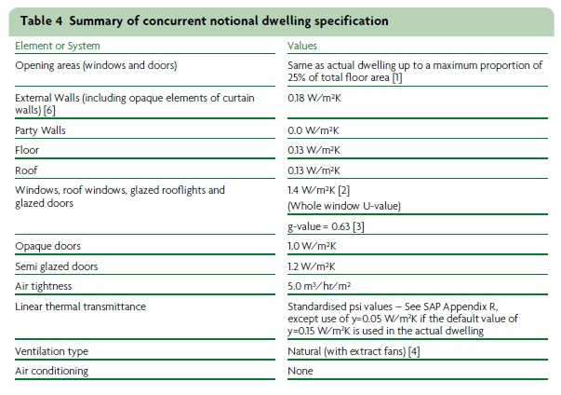
Summary of main changes – L1A
Model Designs (Notional Dwelling)

Slide 18
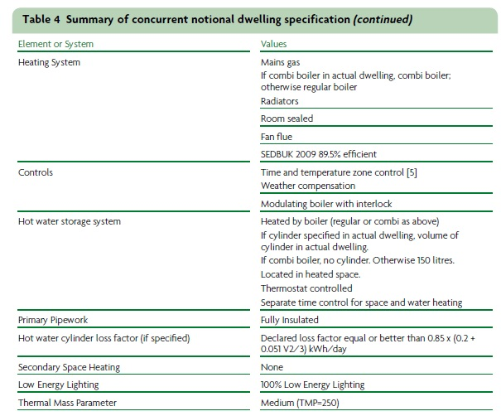
Summary of main changes – L1A
Model Designs (Notional Dwelling)
Notes:
Notes to the table indicate consideration being needed to factors such as daylighting, orientation of the dwelling, extract fans and heating controls

Slide 19
Summary of main changes – L1A
Model Designs (Other…)
Meet TER by constructing to the Model Design
Other designs – www.modeldesigns.info
Still necessary to go through the procedures described for compliance with the requirements for criterion 1.
Notes:
Constructing to the model design – if constructed entirely to this specification it will meet TER and better TFEE and pass criterion 1. This may not produce the most economic design.
Other designs may be available – website currently contains only one set of designs for steel framed buildings in relation to Part L 2006

Slide 20
Summary of main changes – L1B
L1B : Existing dwellings
No significant technical changes
Third party guidance and typographical errors
Window and doorset energy ratings
U-values for rooflights
Subtle changes
Conservatories
Controlled fittings
Changes already implemented post 2010
Notes:
No upgrading or enhancement of any performance criteria
New reference to third party guidance on window energy ratings and introduction of doorset energy ratings
Rooflights – new reference to third party guidance on establishing U-values on the developed area of the rooflights
Conservatories – where conservatory no longer exempt because of removal or doors or extension of heating system reference to a change of energy status has been removed
Energy ratings – detailed guidance removed from the AD and reference made to a GGF guidance document and also possibility of using other certification schemes
Doorsets and glazed doors – simplified guidance on dealing with replacing doorsets and door leafs. Also, definition of glazed door changed, 50% to 60% of doorset area
Replacement fittings – additional commentary given to clarify that doors are included as well as windows, explanation of centre pane U-value, and comments of performance where using enhanced thicker glazing (eg for wind loads, security or acoustic attenuation)
Changes post 2010 – improved guidance on renovating thermal elements in terms of clarifying when the works become controllable.

Slide 21
Part L2
NON-DOMESTIC BUILDINGS

Slide 22
Summary of main changes – L2A
Part L2A : New Non Domestic Buildings – key changes
Target for 2013: Aggregate 9% reduction in CO₂ emissions compared to a Part L 2010 compliant building.
Methodology recognises the diversity of the non-domestic sector
‘Aggregate’ CO₂ reduction across all building types
“Absolute‟ targets (e.g. Target Fabric Energy Efficiency ) considered inappropriate
Regulation 25B – Nearly zero energy requirements for new buildings (2019 at the earliest..)
Consolidation of amendments made in December 2012

Slide 23
Summary of main changes – L2A
Part L2A : New Non Domestic Buildings
Applies to ‘non dwellings’:
Construction of a new building
Fit out works (e.g. first fit out of shell and core)
Construction of extension >100m² AND greater than 25% of the total useful floor area.
Exempt buildings:
Places of worship
Temporary Buildings (2 years or less – e.g. modular/portable building)
Industrial sites, workshops and non residential agricultural buildings with ‘low energy demand’.

Slide 24
Summary of main changes – L2A
Compliance with the five criteria (No fundamental changes)
Achieving the TER
2. Limits on design flexibility
3. Limiting the effects of heat gains in summer
4. Building performance consistent with the BER
5. Provisions for energy efficient operation of the building

Slide 25
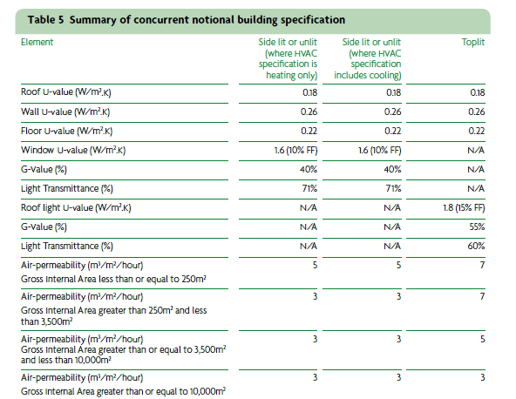
Summary of main changes – L2A
Model Designs (Notional Building)

Slide 26
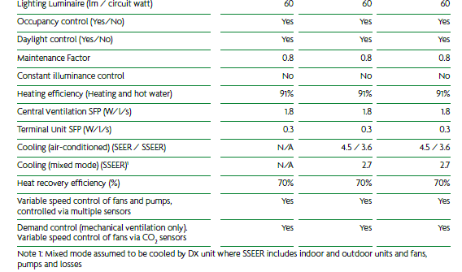
Summary of main changes – L2A
Model Designs (Notional Building)

Slide 27
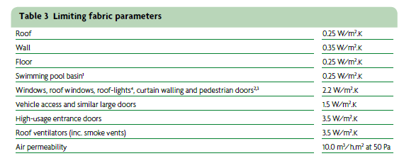
Summary of main changes – L2A
Minimum fabric standards – no change from Part L 2010

Slide 28
Summary of main changes – L2A
Other changes…
Consider High Efficiency Alternative Systems
Technical , environmental and economic feasibility study covering;
Decentralised Energy from renewable sources (e.g. solar, hydro, geothermal, biomass etc.)
Cogeneration (e.g. CHP or CCHP)
District or block heating or cooling
Heat Pumps
Consider low distribution temperatures and control strategies that prioritise low carbon technologies.
Allow buildings to be connected to future heat networks (e.g. capped connections)

Slide 29
Summary of main changes – L2A
Other changes…
Part L2A also covers minimum provision of;
Controls
Energy meters
Centralised switching (e.g. computers)
Commissioning;
Prepare a commissioning plan;
Submit notice to BCB declaring that commissioning has been carried out.
Provision of additional information;
Building services (specification)
Maintenance requirements
EPC recommendations report

Slide 30
Summary of main changes – L2B
L2B : Existing Non Domestic Buildings
No significant technical changes
L1B and L2B 2013 to be included in consolidated document - to be published prior to 6 April 2014

Slide 31
Notification &
Improving Compliance

Slide 32
Part L - Notification
Must notify building control body for inspection at all relevant stages of the work unless the work is self certified by a registered competent person
Responsibility for compliance;
Agent, designer, builder or installer
Building owner
If building does not comply – Building owner may be served an enforcement notice

Slide 33
Part L – Improving Compliance
Key changes to Building Control:
Reduce burdens
Encourage industry to take greater responsibility
Level the playing field between building control bodies
How?
LA required to issue completion certificates for all buildings
Less regulations for Local Authorities and Approved Inspectors (reduce LA and AI burden)
Extend competent person self-certification schemes
Increase fine limit
Introduce new civil enforcement sanctions:
Stop notices
Compliance and restoration notices
Penalties (fixed & variable)

Slide 34
Questions??
Matt Cotton:
matt.cotton@nef.org.uk

