Slide 1
Getting District Energy off the wish list and into the ground
Sean Rendall
Operations Manager

Slide 2
Outline
The wish list
Case study – Thameswey Energy and TCMK
Opportunities for LAs /LEPs to lead

Slide 3
DE meeting LA/LEP objectives
Contributor to corporate objective | ?
Carbon emissions | ✓
Affordable energy | ✓
Planning delivery | ✓
Civic leadership | ✓
Place making/regeneration/competitive advantage | ✓
Investment opportunity/revenue diversification | ✓
National policy | ✓
Leverage investment | ✓
Localism, skills, green economy | ✓
or

Slide 4
Thameswey Group - background
Set up by Woking Borough Council in 1999
EESCo - Energy and Environmental Services Company
Special Purpose Vehicle – PPPs, JVs, acquisitions
WBC sole shareholder
Assets £76m (2012)
Operates across whole UK, centres of business in Woking and Milton Keynes
£13.9m turnover (2012)
£1.5m revenue to WBC (vs. £8m from Council tax)

Slide 5
Thameswey Group - Purpose
To deliver sustainable development priorities:
Enable an accelerated programme
Provide a vehicle that is responsive to the council’s objectives
Focus on high cost/long term/innovative projects
Operate within realm of hard to finance infrastructure
Manage and share risk (financial and political)
Exist and operate outside scope of day to day service
Attract skills and expertise
Operate with greater freedom of business
Create an enterprise environment
Build corporate capacity

Slide 6
TDL
TSC
TEL
TH
TMS
TSL
RWL
TCMK
BRC
RWCL
Land and Development
Services and
Consultancy
Housing
Maintenance
Services
Solar
Energy
ESCos
The Thameswey Group April 2013

Slide 7
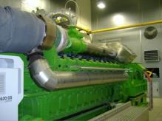
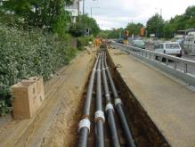
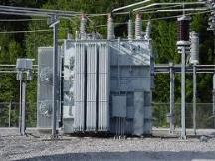
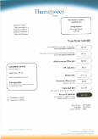
Scope of Thameswey ESCos
Generation
Distribution
Supply

Slide 8
Roles
Generator
Distributor
Supplier
Fuel purchase, plant optimisation, operating Maintenance and service Market price response (aggregators, triad etc)
Customer and generator interfaces Interface with grid New connections
Metering, billing Customer services Installation and maintenance of new connections

Slide 9
Cost and Risk profile
Generator
Distributor
Supplier
Capex | High | High | Low
Capex costs | Energy centre | Heat mains, HV/LV network | Heat exchangers, meters
Opex | High | Low | Low
Opex costs | Fuel, maintenance, labour, loans, depreciation | Maintenance, loans, depreciation | Grid energy, customer services, administration
Income | Energy sales, ROCs, FITS, RHI | Transmission charges, new connections | Energy sales, maintenance charges
Risk | High | High - Med | Med - Low

Slide 10
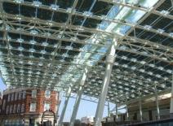
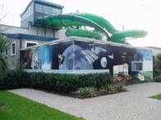
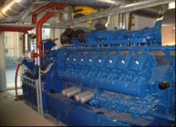
Thameswey Energy Ltd.
Formed 1999
Satellite community CHP and DH systems, 0.75 MW PV
1.2 MWe CHP in leisure centre and pools
1.4 MWe CHP Woking town centre
Public, private and commercial customers including Civic Offices, hotels, private and RSL apartments, nightclub and entertainments, conference centre, museum and art gallery
Commercial office block, shopping centre, new WWF UK HQ (2013)

Slide 11
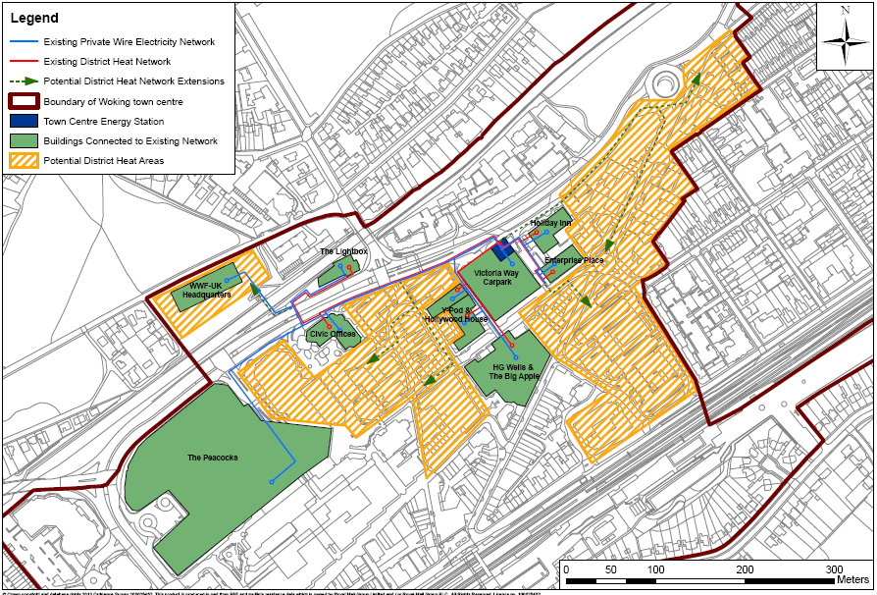
Woking town centre networks

Slide 12
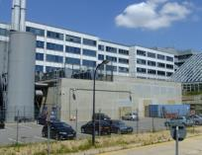
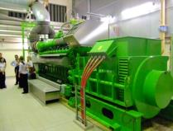
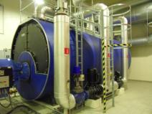
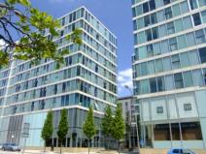
Thameswey Central Milton Keynes Ltd.
Set up in 2005,
Partnership with English Partnerships (HCA)
Construct and operate CHP DH and private wire networks for phased development of central MK
Delivered through turnkey contract with JV partner
Connections secured through Project Development Agreement
Sales revenue £3m (2012)

Slide 13
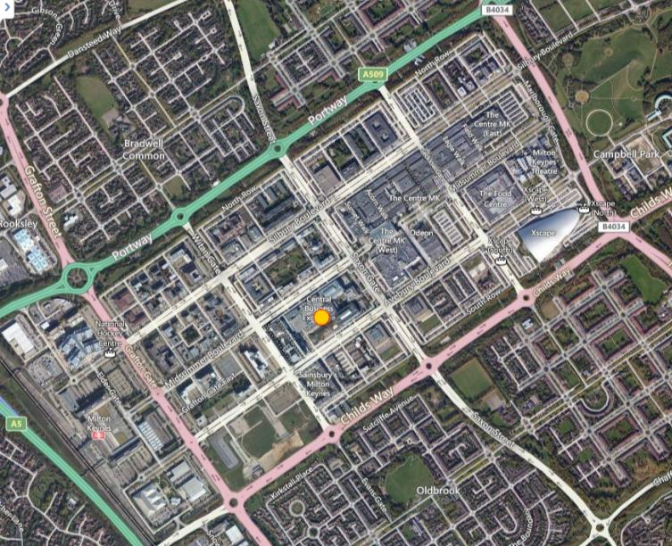

Slide 14
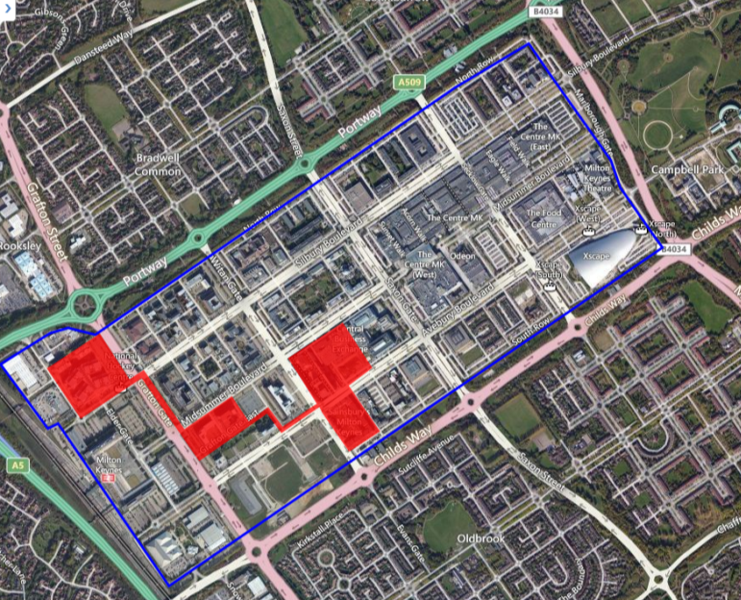
Area of PDA
Connected within PDA
Connected outside PDA

Slide 15
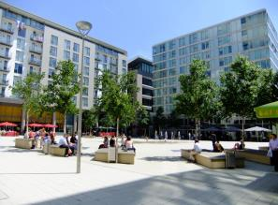
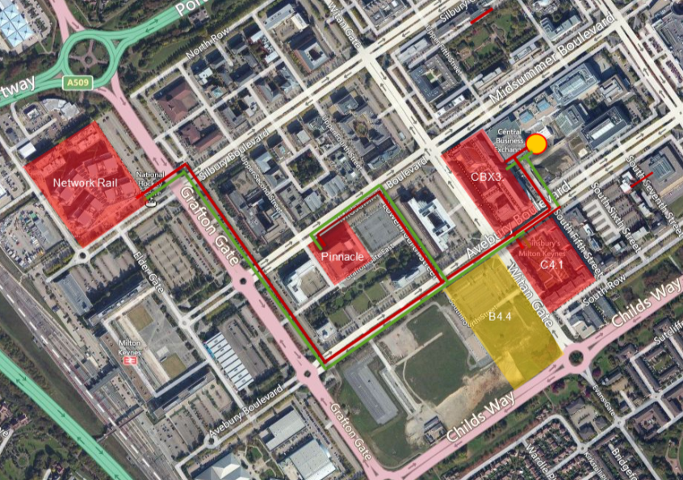
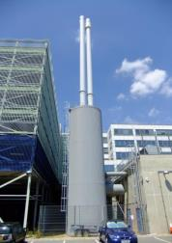
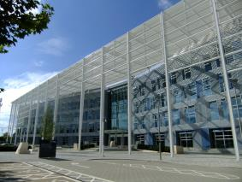
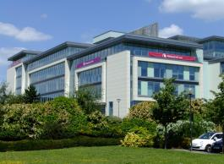
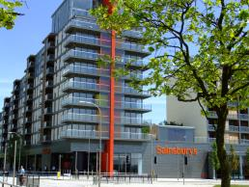
The Hub (CBX3)
11,000m² office, retail and 400 apartments
Energy Centre
6 MW CHP
10 MW boiler
‘Vizion’ (C4.1)
14,000m² retail
450 apartments
Network Rail HQ
37,000m² office space
The Pinnacle
18,000m² high spec office , 995m² retail

Slide 16
Investment structure
Shareholder capital and loans £16.3m
10 year commercial loans (8%)
Shareholder lending (PWLB plus margin)
Developers’ contributions £5.57m
EP/HCA Payments £2.81m
Operational business plan of 32 years
Target IRR 12%
Revenue from sales of energy to customers and grid (STOR)
* 2013 forecast

Slide 17
Local authorities (and LEPs) strategic leaders
Multiple public policy objectives (carbon reduction, growth, infrastructure etc)
Control, responsibility and influence
Strategic planning powers
Asset managers, landowners and developers
Investors
Borrowing powers – PWLB/pension funds
Decisions based on long termism

Slide 18
sean.rendall@thamesweygroup.co.uk

