Slide 1
Fuel Poverty: Smarter Targeting
Adam Goulden
the Environment Centre (tEC)
Notes:
Good morning
Introduction
About Tec – Based in Southampton and we’ve been working in the promotion and practice of environmental sustainability for over twenty years. For the last ten years or so we have really specialised in the field of Energy efficiency and particularly Fuel Poverty. We currently run projects in Southampton and Hampshire and provide a Freephone advice line for all Hampshire Residents. We also provide a Home Visiting service for vulnerable residents and access to a wide variety of funding for EE improvements. I’m hear today to talk to you about one of our projects Southampton Health Homes and to explain a little about how we are going about targeting fuel poor and vulnerable residents in the city.

Slide 2
Fuel Poverty in Southampton
10.3% of households in Southampton are at risk of fuel poverty (DECC, May 2015)
Higher than the average of 6.7% in Hampshire
19% of properties have an EPC rating of E-G
An average of 108 excess winter deaths per year
Notes:
Southampton experiences its own particular problems related to fuel poverty.
DECC have recently calculated that 10.3% of households in Southampton are at risk of fuel poverty…that is some 10,000 properties
This is higher that the average for the south east which is 8.1% and across Hampshire 6.7%.... so Southampton has one of the highest rates of fuel poverty in the region.
We have found that this figure is as high as 29% in some areas of the city
Causes of fuel poverty in Southampton include:
Low incomes
Poor housing stock - the stock condition survey completed in 2008 for Southampton (to be updated in 2015/16) identified that 95% of properties across the city could significantly benefit from EE improvements.
High numbers in private rented accommodation - The city has over twice the national average of private-rented accommodation (24%) and much of this is in poor repair.
An aging population
Just going back to housing and energy efficiency
19% of properties in Southampton have an EPC rating of E-G
Below the national average rating of D
A large scale stock condition survey carried out in 2008 showed that 38% (28,400) of all private homes did not meet the Decent Homes Standard and that 8,500 of these are occupied by vulnerable people. (Ref: Draft Southampton City Health & Well-Being Board Housing and Health Report pg. 14)
Excess winter deaths –
Cold, damp and draughty homes have a serious impact on health and wellbeing, and sadly 108 people died in Southampton last winter due to the effects of cold homes (National Energy Action, 2014)
Southampton is very fortunate in that is has the well established SWAP comprising of SCC housing and health departments, TEC, CAB, AUKS, SURE Start, etc.. Over the last few years the partnership have developed a fuel poverty strategy for the City and when an opportunity arose to bid for significant funding through BGEN the partnership leaped at it. Led by Tec but with a great deal of support from Southampton City Council particularly Public Health and Housing the consortium looked to incorporate a blend of new and innovative and tried and tested ideas within the bid…and I am delighted to say that it was ultimately successful.

Slide 3
Southampton Healthy Homes
0800 804 8601
02380 336 172
keepwarm@environmentcentre.com
www.environmentcentre.com
Notes:
So firstly the tried and tested:
We received 500k - Approximately half of that is project costs and the rest is for practical works…however we have a commitment to doubling the practical budget through match funding from SCC and a variety of charitable trusts…so we should be looking at about 500K
We at the Environment Centre provide a single point of contact for anyone concerned with staying warm and well via our free phone number, dedicated e-mail address and webchat facility.

Slide 4
Support by the Caseworkers
Project Manager
2 x Energy Advisers - tEC
Support given by the advisers:
Telephone advice
Prearranged home visits
Drop-in sessions
Notes:
We employ a project manager and two project officers who are able to assist with any enquires relating to the project
Referrals can come from:
a home visiting officer from any agency, voluntary organisation, local authority…we have a wide network of referral agents throughout the city already but we are also running a series of training sessions for front line staff over the coming months and providing all home visiting staff across the city with an affordable warmth checklist
Direct call from a client…our contact details will be widely publicised across the city on a number of different platforms
Or a call from a family member of a friend concerned for a clients wellbeing.
Our energy advisers can help
Any Southampton resident with any questions around affordable warmth, energy efficiency, or the types of support available over the phone
Organise home visits for those most in need – either
Where the grant through this scheme may be used to improve the energy efficiency of the home or
Where help cannot be given over the phone but the client is in need of support
We can also provide information on a variety of other topics including healthy living, flu jabs and smoking cessation..
Energy adviser(s) – tEC
About the energy advisers
City and Guilds – Energy Awareness
Experienced in attending home visits and providing energy advice
Aware and sensitive to the needs of vulnerable clients
What they do
Free and impartial energy advice over the phone
Signpost to other agencies / services
Make direct referrals on to other agencies
Arrange for the Benefits and Budgeting Adviser to contact the client if necessary
Advise on grants for energy efficiency improvements – boilers, insulation
Home visits
Bespoke energy advice
Fuel or tariff switching
Hand holding support for clients applying for grants for energy efficiency improvements to the home, including for grants available through this service
Home energy assessment to provide an Energy Performance Certificate (EPC) for the home, providing recommended measures to improve the energy efficiency of the home
Support given by the advisers:
Telephone advice
Prearranged home visits
Drop-in sessions at other organisations, etc where we can provide the advice, either prearranged or drop in sessions

Slide 5
Practical Interventions
Emergency heaters
Home energy improvements
Small grants
Food basics and hot meals
Notes:
Emergency heating
To help those with no heating and provide temporary relief in emergency situations
Grants for home energy improvements
Help clients to access grants, such as the Energy Company Obligation (ECO) and other support
This service is good as there is money available for work not covered by ECO, eg boiler replacements for those not covered by ECO, draught proofing, window replacements
This service also offers grants for enabling measures, which means clients can then have work done under other schemes, such as ECO – eg loft clearances so allow loft insulation to then be done through ECO
Small grants
To help residents cope with winter emergencies, eg utility top ups (extremely useful where clients have to use temporary electric heaters which cost more to run)
Can help with essential white goods / furniture packages
Food basics and hot meals
The food basics will include food from food banks, such as the Basics Bank

Slide 6
Projected outputs of the Service
2,000 people helped
450 people ‘hand-held’ for further support
100 energy efficiency improvements made
£120,000 of unclaimed benefits claimed
Notes:
The key outputs of this service will be:
2,000 people / households assisted through this service
450 beneficiaries given bespoke ‘hand-holding’ support
100 bespoke energy efficiency interventions made for Southampton households, using the funding available through this service
£120,000 of unclaimed benefits secured for vulnerable households
£30,000 funding leveraged for the energy efficiency improvements
10 training sessions for frontline staff and volunteers

Slide 7
Project Champions
Statutory Services (Public Health)
Working with other health professionals
To promote this project and provide help to further residents
Faith Communities (Alder Trust)
Working with the faith groups throughout the city
To promote and identify vulnerable residents in cold homes
Benefits and Budgeting Advisor (CAB)
Income maximisation and household budgeting advice
Notes:
So on to the new and innovative:
Through this project there will be two project champions:
Faith Communities Champion – Employed through the Alder trust
Will work with all of the faith groups throughout the city to and promote the project and identify vulnerable customers living in cold homes
Statutory Services Champion – will come to us through public health and
Will work with other health professionals and the statutory service to make them aware of this project
Will then mean we can help those who we’ve previously been unable to reach.
Benefits and Budgeting Adviser – Citizens Advice Bureau (CAB)
About the Benefits and Budgeting Adviser
What they do
Income maximisation and household budgeting advice
Advise on benefit entitlement
Assistance with applications for benefits
Specialist debt support
Will be able to carry out home visits to those most in need

Slide 8
Community Engagement
Marketing and promotion
Faith Communities Champion
Statutory Services Champion
Community/voluntary sector networks
Training for front-line staff and volunteers
Targeted promotion – data mapping tool
Notes:
So the project will be promoted on a variety of platforms throughout the city including in the press, on bill boards, through social media and on the web and through our community champions who will be able to get out an about and help those hard to reach and particularly vulnerable customers that so often slip through the net:.
Faith Communities Champion – Employed through the Alder trust
Will work with all of the faith groups throughout the city to and promote the project and identify vulnerable customers living in cold homes
Statutory Services Champion – will come to us through public health and
Will work with other health professionals and the statutory service again to help those who we’ve previously been unable to reach.
Community/voluntary sector networks
Southampton Voluntary Services
Southampton Anti Poverty Forum
Training for front-line staff and volunteers
Training on fuel poverty, energy efficiency and healthy living
To provide knowledge so frontline workers know who to direct clients to and what help is available for them
Affordable warmth checklist provided to attendees – key points on how to spot clients who may be in or at risk fuel poverty
Targeted promotion – data mapping tool

Slide 9
EPC Mapping Southampton
http://www.environmentcentre.com/maps/Southampton/EPC.html

Slide 10
Mapping EPC data Solid Walled private homes in Southampton
Notes:
tEC uses data from Energy Performance Certificates to be able to target those at need, in potentially cold, expensive to run homes.
This sample map shows solid walled properties in Southampton.

Slide 11
Mapping EPC data

Slide 12
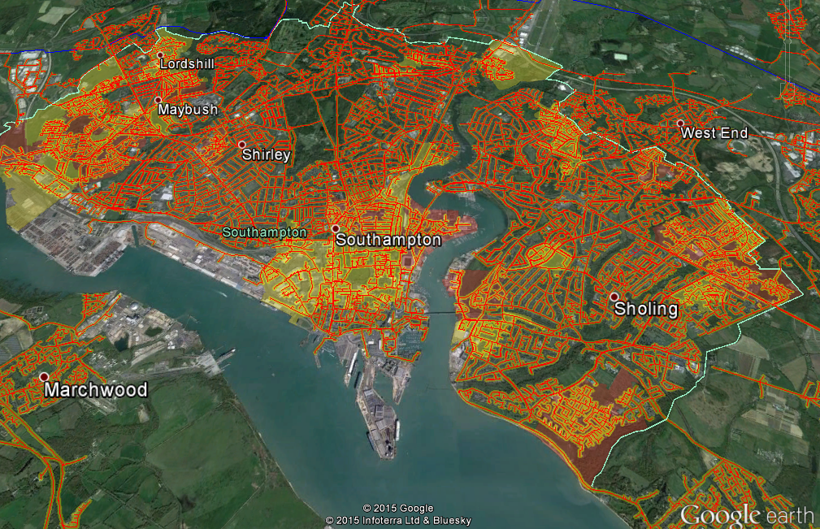
Mapping data Off the gas network properties in Southampton

Slide 13
Evaluation of the Southampton Healthy Homes Project
Aims
To identify the outputs of the Southampton Healthy Homes (SHH) project and estimate the impact of the project on the health of the city’s residents
Methods
Baseline data from all who contact the project hub will be collected by tEC including demographic information, reason for contact and any health conditions
Health and wellbeing of households will be assessed by surveys at baseline and following completion of interventions delivered via the SHH project
Formal academic evaluation in conjunction with the University of Southampton will aim to use qualitative methods such as interviews and focus groups with residents, as well as the Hampshire Health Record to detect changes in use of healthcare

Slide 14
Q and A

